Slide 1

AirBed&Breakfast Data Analysis
Diksha Bhushan Waghmare
BugendaiTech Data Science Intern
Team Ayush

Slide 2
Agenda
Airbnb Data
Price Distribution
Number of Reviews
Average price by Neighbourhood group and Room type
Correlation method
Linear Regression
Conclusions

Slide 3
AirBnB Data
AirBnB New York data was downloaded from Kaggle. It has 48895 rows and 16 columns. AirBnB data has the following features.
id
name
host_id
host_name
neighbourhood_group
neighbourhood
latitude
longitude
room_type
price (Target Variable)
minimum_nights
number_of_reviews
last_review
reviews_per_month
calculated_host_listings_count
availability_365

Slide 4
Process
1. checked the problem statement
2. read the file
3. Used basic pandas functions or methods like head, tail, shape, size, info, describe, to together some information about my dataset.
4. Used the chi2 test to check the relation between the target numerical column to categorical columns.
5. Used correlation method to check the relation between numerical features to target features.
6. Drop some irrelevant features
7. Data visualization to check the outliers
8. Used IQR method to remove outliers
9. Converted categorical features into numerical features using Labelencoder
10. Applied standardization in independent features
11. Split into train and test
12. Applied multiple linear regression.
13. Model is under fitted because the model is biased and variation is low
14. Used ridge and lasso but not worked properly
15. Convert the target variable into 2 groups expensive and cheap with threshold 106.
16. Used logistic regression
17. Got an accuracy of 81.53 percent

Slide 5
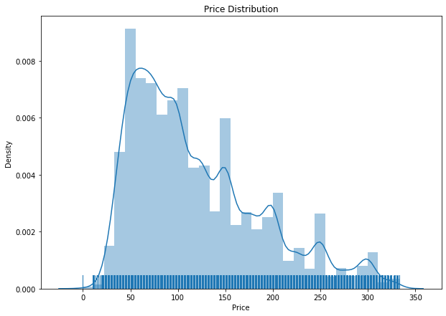
Price Distribution (Target Variable Distribution)
Most price ranges are between $50 to $150
Average price is around $120
Maximum price is around $335

Slide 6
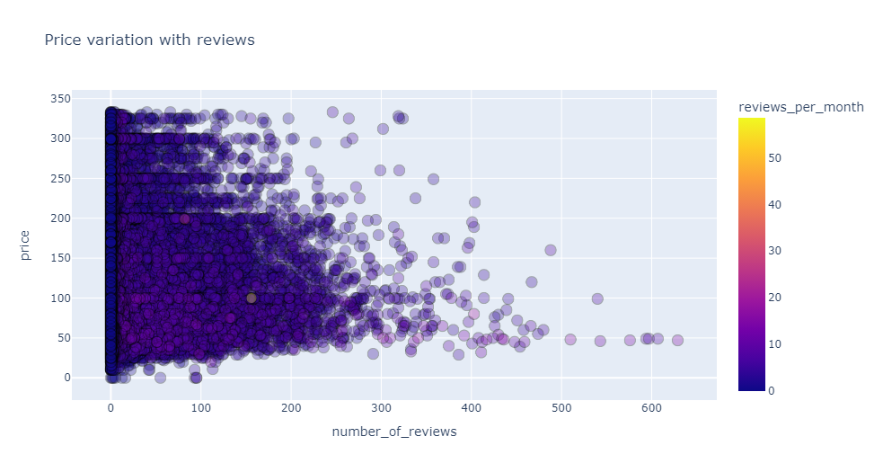
Number of Reviews (Number of reviews Vs Price)
Prices of listing do not have any direct relation with the number of reviews
We have all the prices (max to min) irrespective of the number of reviews

Slide 7
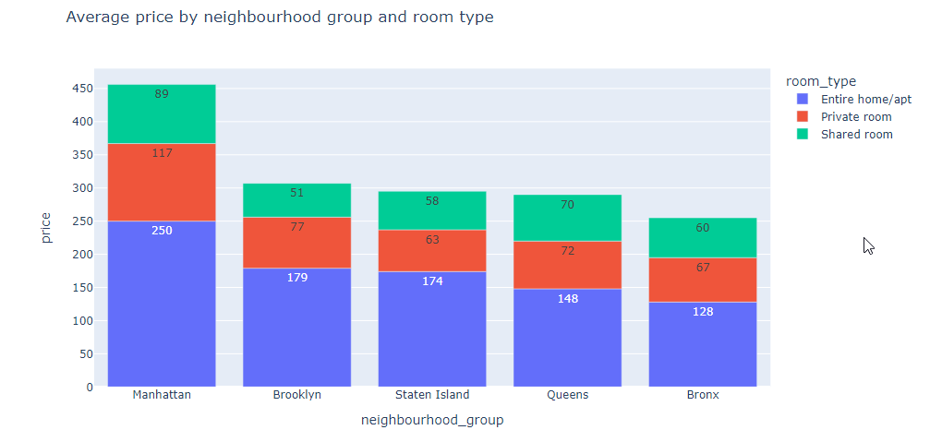
Average price by Neighbourhood group and Room type (Average price Vs Neighbourhood group, Room Type)
There are three room types viz. Entire home/apt, private room, shared room
Manhattan has the highest average price for all room types followed by Brooklyn
Bronx is cheapest for all room type

Slide 8
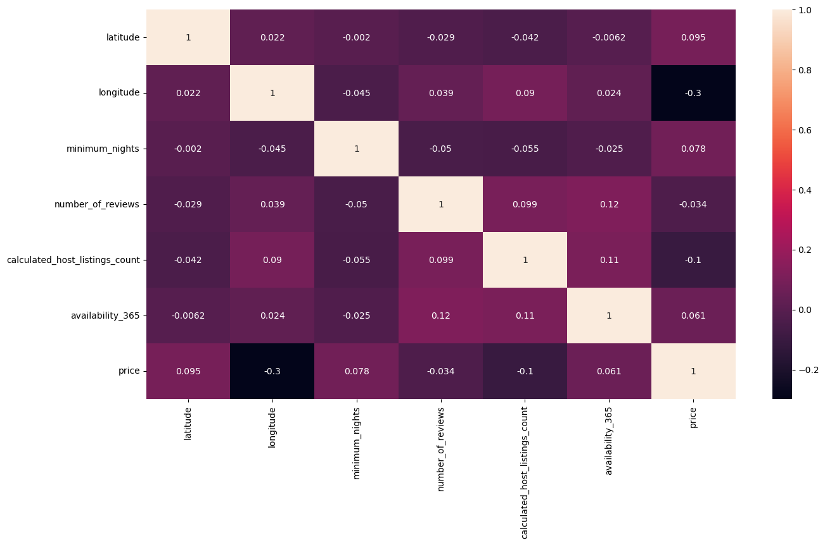
Correlation method
Here we check the correlation between all the columns in Airbnb.

Slide 9
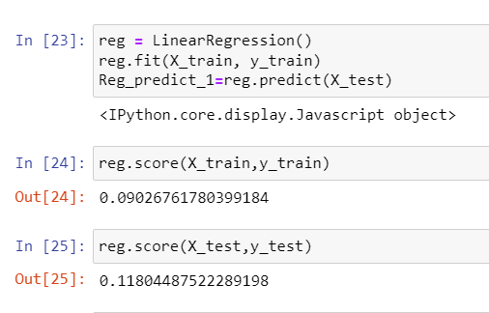
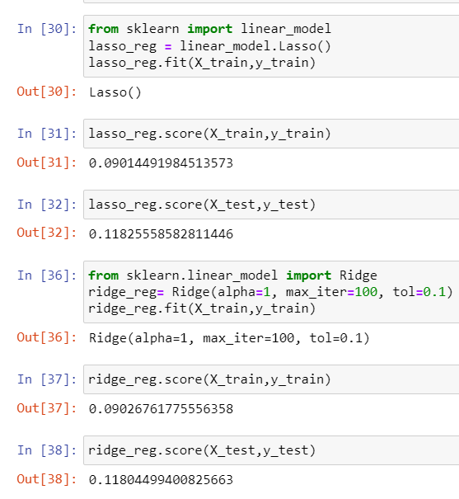
Linear Regression
Converted categorical features into numerical features using Labelencoder
Applied standardization in independent features
Split into train and test
Applied multiple linear regression.
model is under fitted because the model is biased and variation is low
So, here we used ridge and lasso but not worked properly

Slide 10
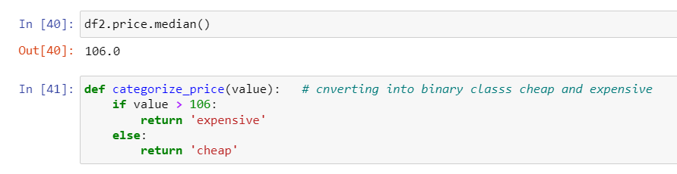
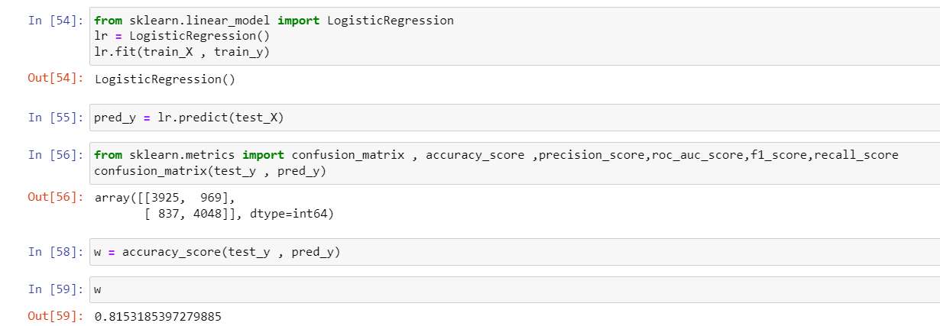
Logistic Regression
convert the target variable into 2 groups expensive and cheap with threshold 106.
Used logistic regression
Got an accuracy of 81.53 percent

Slide 11
Conclusions
From price distribution we can observe that Most price ranges are between $50 to $150.
With the increase in price, the average vacancy days are increasing rapidly.
There is a cluster in Manhattan of expensive neighborhoods that are situated close to each other.
Data is underfitting
We got an accuracy of 81.53 so the model is good.

Slide 12
Thank You

